Slide 1
European Urban Initiative: Capacity Building
Launch of Capacity Building calls
URBANET

Slide 2
EUI CAPACITY BUILDING
Overall target group
EU cities of all sizes involved or interested in Sustainable Urban Development within Cohesion Policy
Two objectives
Improve the capacities of cities to design and implement SUD strategies, policies and practices in an integrated and participative way
Improve the quality of the design and overall implementation of SUD strategies, policies and practices

Slide 3
SUSTAINABLE URBAN DEVELOPMENT
Article 11
ERDF/CF Regulation
Article 11 “Sustainable Urban Development”
Handbook for Sustainable Urban Development Strategies
New Leipzig Charter
Building capacities of urban authorities on these challenges is key to ensuring that SUD strategies and related Cohesion Policy investments deliver good results

Slide 4
THREE ACTIVITIES
Notes:
City-to-city exchanges
In-person visits with online follow-up option
Applicant + 1 or 2 peers
Tackling implementation challenges identified by applicant
Involving urban authorities, plus stakeholders when justified
Peer reviews
3-5 SUD strategies reviewed together
City under review paired with ca. 4 peers
2-day event with structured preparation
Organised at different scales: EU-wide, multi-country or country-specific
Involving urban authorities, plus stakeholders when justified
Capacity building events
Tackling implementation of Article 11 and synergies between Cohesion policy, UIA/EUI-Innovative Actions, URBACT IV and the Urban Agenda for the EU
Organised in various formats (seminars, workshops, trainings) and at different scales (EU-wide, multi-country, or country-specific), mixing expert-led and peer learning
Involving urban authorities, managing authorities, European Commission and stakeholders when justified

Slide 5
CITY-TO-CITY EXCHANGES
What is a city-to-city exchange?
brings together an urban authority facing a specific implementation challenge related to SUD (‘the applicant’)
and another urban authority from a different EU Member State with expertise to help tackle this challenge (‘the peer’)
short-term, quickly implemented visit
designed by the applicant according to their needs
aims to improve capacity of the applicant to tackle the identified SUD challenge through peer learning

Slide 6
CITY-TO-CITY EXCHANGES
Flexible, bottom-up activity
Peers: 1-2 cities from other EU Member States with expertise needed to address challenge
Number of events: 1-3 events per application
Format: In-person visits between applicant city and peers
1. Incoming visit - peer(s) travels to applicant city
2. Outgoing visit - applicant travels to peer city
If justified, possibility for online exchange following in-person visit
Duration: 2-5 days per event
Timing: Start as soon as possible, all exchanges completed within 5 months of approval

Slide 7
CITY-TO-CITY EXCHANGES
Who may apply?
Urban authorities within EU Member States
Interest or involvement in integrated, place-based approaches to SUD
Relevant stakeholders may participate alongside urban authority, if justified
Who may participate as a peer?
As above, plus:
Must have expertise and experience needed to address the applicant’s challenge
Must come from other EU Member State to the applicant

Slide 8
CITY-TO-CITY EXCHANGES
What support is available?
Funding to support applicants and peers (urban authorities, and stakeholders if justified)
Type of cost Applicant City Peer City
Travel, accommodation & subsistence Up to 4 people Up to 2 people
Daily rate covering staff time No Up to 2 people
Expertise: EUI can appoint a moderator to facilitate exchange and learning process
Peer identification: EUI can facilitate contact with urban authorities involved in UIA / EUI – Innovative Actions and the Urban Agenda for the EU. A peer search platform will be developed on Portico in the long-term

Slide 9
PEER REVIEWS
What support is available?
Funding to support Cities under Review (urban authorities and stakeholders) and Peers (individuals from urban authorities)
Type of cost City under review Peer
Travel, accommodation & subsistence Up to 4 people Up to 2 people
Daily rate covering staff time No Up to 2 people
Expertise: two peer review experts per City under Review to guide the process, facilitate exchange & learning process and draft the expert report
Peer identification: experts identify relevant peers to support each City under Review

Slide 10
PEER REVIEWS
What is a peer review?
3-5 cities under review benchmark their SUD strategies and get peer recommendations
2-day event with structured preparation
Aims to improve capacity of cities under review in designing/implementing SUD strategy

Slide 11
PEER REVIEWS
A fixed methodology and implementation process of 4 to 6 months
3 guiding questions defined by cities under review, building on:
Six building blocks of Handbook for SUD Strategies
Weaknesses identified by SAT4SUD results
Validated through stakeholder consultation
3 sessions each addressing one question:
Reframe the question
Share relevant experiences
Provide insights & recommendations
Documented in expert report, completed by city under review

Slide 12
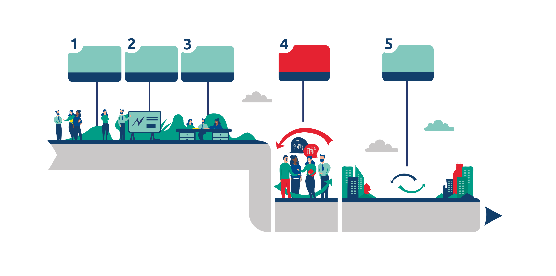
PEER REVIEWS
Implementation milestones
Application for cities under review
Content preparation
Follow-up activities
Call for peers
Peer review
8 weeks
4 weeks
8 weeks
2 days
6 months
Application with SAT4SUD
Matching of cities under review & peers
Background paper drafted
Preparatory webinar
List of use cases from peers
2-day in-person event
Expert report received
Follow-up report
Follow-up webinars

Slide 13
PEER REVIEWS
Who may apply?
Urban authorities within EU Member States (cities under review may involve stakeholders)
Designing/updating SUD strategy in line with article 11 of ERDF Regulation
Who may participate as a peer?
As above, plus:
Must have expertise and experience needed to address the identified challenges
Must come from other EU Member State to city under review
Must be ready to personally participate in event (apply as individual)

Slide 14
PEER REVIEWS
What support is available
Funding to support Cities under Review (urban authorities and stakeholders) and Peers (individuals from urban authorities)
Type of cost City under review Peer
Travel, accommodation & subsistence Up to 4 people Up to 2 people
Daily rate covering staff time No Up to 2 people
Expertise: EUI will appoint two peer review experts per City under Review to guide the process, facilitate exchange & learning process and draft the expert report
Peer identification: EUI experts identify relevant peers to support each City under Review
Logistics: EUI will organise the peer review event (venues, catering & other services providers)

Slide 15
EVENTS
Capacity building events:
Bring together urban authorities and managing authorities to exchange information with each other and with the European Commission on horizontal and thematic policy issues related to SUD
Top-down and bottom-up approach to initiation
Objectives:
provide a ‘space’ for exchange
facilitate the creation of a growing community of cities
provide easier access to knowledge and capacity building
Geographical scope: EU-level, cluster of Member States, Country-specific
Notes:
Capacity building events bring together urban authorities and managing authorities (Regional, national) to exchange information with each other and with the European Commission. Thematically, the events address the implementation of Article 11 and innovative actions across the EU, as well as horizontal and thematic policy issues related to Sustainable Urban Development (SUD). The events build upon the Urban Development Network activities of the 2014-2020 period, and will showcase the synergies between Cohesion policy, UIA/EUI-IA, URBACT IV and the Urban Agenda for the EU.
The capacity building events are designed in response to urban policy makers’ needs, identified in two ways:
top-down through consultation between EUI, DG REGIO and EUI partners
bottom-up through surveys and needs’ analysis carried out in the context of the Knowledge Exchange and Sharing Platform and territorial impact survey results.
The objective of capacity building events is to provide a ‘space’ for exchange between cities interested or involved in the implementation of SUD strategies, other cities interested in integrated approaches, Managing Authorities (MAs) and other stakeholders to encourage networking, good practice exchange, and capacity building through sharing the lessons learned from others and training sessions.

Slide 16
EVENTS
Target groups
Open to local, regional and national practitioners and policymakers interested or directly involved in Sustainable Urban Development within Cohesion Policy
Methodology and formats
In-person and online seminars, workshops, conferences, webinars, matchmaking activities, site visits or training sessions mixing peer learning and expert-driven modules
Article 11 Cities | Managing authorities of Cohesion Policy programmes | UIA/EUI Innovative Actions projects
URBACT networks | Urban Agenda for the Partnerships | Other cities and stakeholders interested in SUD

Slide 17
WHY ENGAGE AS A PEER?
Five good reasons
Build your own capacity by learning how other cities tackle and solve similar challenges that you’ve faced or may face in the future
Multiply your impact by exporting your solutions to other urban contexts and promoting these transfers at EU-scale
Develop your profile as a front-runner on Sustainable Urban Development
Build your EU network and foster new partnerships with other EU cities
Promotional opportunities for the most active and impactful peers

Slide 18
COMPLEMENTING URBACT
Improved access to knowledge on integrated & participatory approaches
URBACT cities as source of potential peers for EUI activities
Complementary activities for non-URBACT cities next to URBACT events (e.g. national schemes)
Improved support for developing & sustaining partnerships
Supporting exchanges among cities before creation of URBACT networks
Supporting cities with any ongoing needs after the closure of an URBACT network
A wider selection of intensity and methodological approaches for capacity building
Short-term activities (EUI) vs longer-term activities (URBACT)
Three new methodologies: one fixed (peer review), one flexible (city-to-city exchanges) plus events
Capacity building opportunities with a lower administrative burden
Simplified processes for application, reporting & reimbursement of EUI activities
First steps for EU networking for newcomer cities
Notes:
Improved access to knowledge on integrated & participatory approaches
URBACT cities as source of potential peers for EUI activities
Complementary activities for non-URBACT cities next to URBACT events (e.g. national schemes)
Improved support for developing & sustaining partnerships
Supporting exchanges among cities before creation of URBACT networks
Supporting cities with any ongoing needs after the closure of an URBACT network
A wider selection of intensity and methodological approaches for capacity building
Short-term activities (EUI) vs longer-term activities (URBACT)
Three new methodologies: one fixed (peer review), one flexible (city-to-city exchanges) plus events
Capacity building opportunities with a lower administrative burden
Simplified processes for application, reporting & reimbursement of EUI activities
First steps for EU networking for newcomer cities

Slide 19
UPCOMING OPPORTUNITIES
City-to-City Exchanges: Call for applications
4 April to 17 November (7.5 months)
Peer Reviews: Call for Cities under Review
4 April to 29 May (8 weeks)
Peer Reviews: Call for Peers for Peer Review in Thessaloniki, end-June
4 April to 30 April (4 weeks)
Events:
End-May: Delivering high-quality urban CLLD, Timisoara, Romania
June: Supporting an integrated approach to urban innovation, location TBC
Experts: Call for Experts to support capacity building activities
Soon closing, 19 March 23:59 CET
Notes:
City-to-City Exchanges: Call for applications
24 March to 17 November (7.5 months)
Up to 100 exchanges to be supported in 2023
Peer Reviews: Call for Cities under Review
24 March to 19 May (8 weeks)
9-12 cities to be identified for 3 events in October-December 2023
Peer Reviews: Call for Peers for Peer Review in Thessaloniki, end-June
By 31 March to 30 April (TBC – minimum 4 weeks)
Events:
End-May: Delivering high-quality urban CLLD, Timisoara, Romania
June: Supporting an integrated approach to urban innovation, location TBC

Slide 20
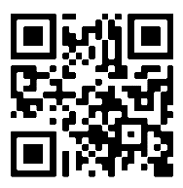
SUPPORT FOR APPLICANTS
Applicant Webinar – 5 April, 10:00 CEST
Supporting applicants for City-to-City Exchanges and Peer Reviews
Peer identification for city-to-city exchange applicants
Form to request contact with urban authority involved in UIA/EUI-IA or UAEU
Email
capacitybuilding@urban-initiative.eu
Website
www.urban-initiative.eu/capacity-building
Notes:
Sustainable Urban Development within Cohesion Policy should be primarily understood in the context of Article 11 of the European Regional Development Fund (ERDF)/Cohesion Fund (CF) Regulation, in conjunction with Article 28 (Integrated territorial development) and Article 29 (Territorial strategies) of the Common Provisions Regulation. Article 11 provides the regulatory framework for urban authorities to design and implement SUD strategies, and to be involved as decision makers in project design and selection. Building the capacities of urban authorities on these challenges is key to ensuring that SUD strategies and the related ERDF investments (minimum 8% of ERDF resources in each EU Member State) deliver good results.
Sustainable Urban Development is also defined in the context of the New Leipzig Charter which highlights that, to achieve just, green, and productive cities, it is necessary to establish integrated and sustainable urban development strategies and ensure their implementation for the city as a whole, from its functional areas to its neighbourhoods.
Article 11 of Regulation (EU) 2021/1058 of the European Parliament and of the Council of 24 June 2021: "To address economic, environmental, climate, demographic and social challenges, the ERDF shall support integrated territorial development based on territorial or community-led local development strategies (…) that are focused on urban areas, including functional urban areas (‘sustainable urban development’)".
Article 28 and Article 29 of Regulation (EU) 2021/1060 of the European Parliament and of the Council
of 24 June 2021
New Leipzig Charter- The transformative power of cities for the common good (europa.eu)

Slide 21
Thank you
© European Union 2020
Unless otherwise noted the reuse of this presentation is authorised under the CC BY 4.0 license. For any use or reproduction of elements that are not owned by the EU, permission may need to be sought directly from the respective right holders.
Slide xx: element concerned, source: e.g. Fotolia.com; Slide xx: element concerned, source: e.g. iStock.com
Notes:
Update/add/delete parts of the copy right notice where appropriate.
More information: https://myintracomm.ec.europa.eu/corp/intellectual-property/Documents/2019_Reuse-guidelines%28CC-BY%29.pdf

